Slide 1
DETECTING MULTIPLE OBJECTS AND SMART NAVIGATION FOR VISUALLY IMPAIRED PEOPLE
A NEXT STEP IN BRINGING LIGHT IN DARK

Slide 2
PRESENTERS
R.M.D ENGINEERING COLLEGE
SRIDHAR S
Shreenath V
Sriram Siddharth dn

Slide 3

AGENDA
ABSTRACT
WHAT IS YOLO V3?
WHY YOLO?
LITERATURE SURVEY
COMPARISON & COMPONENTS USED
FLOW DIAGRAM
HOW IT WORKS?
EXPERIMENTS AND DATASETS
SAMPLE WORK
CONCLUSION
FUTURE WORK

Slide 4
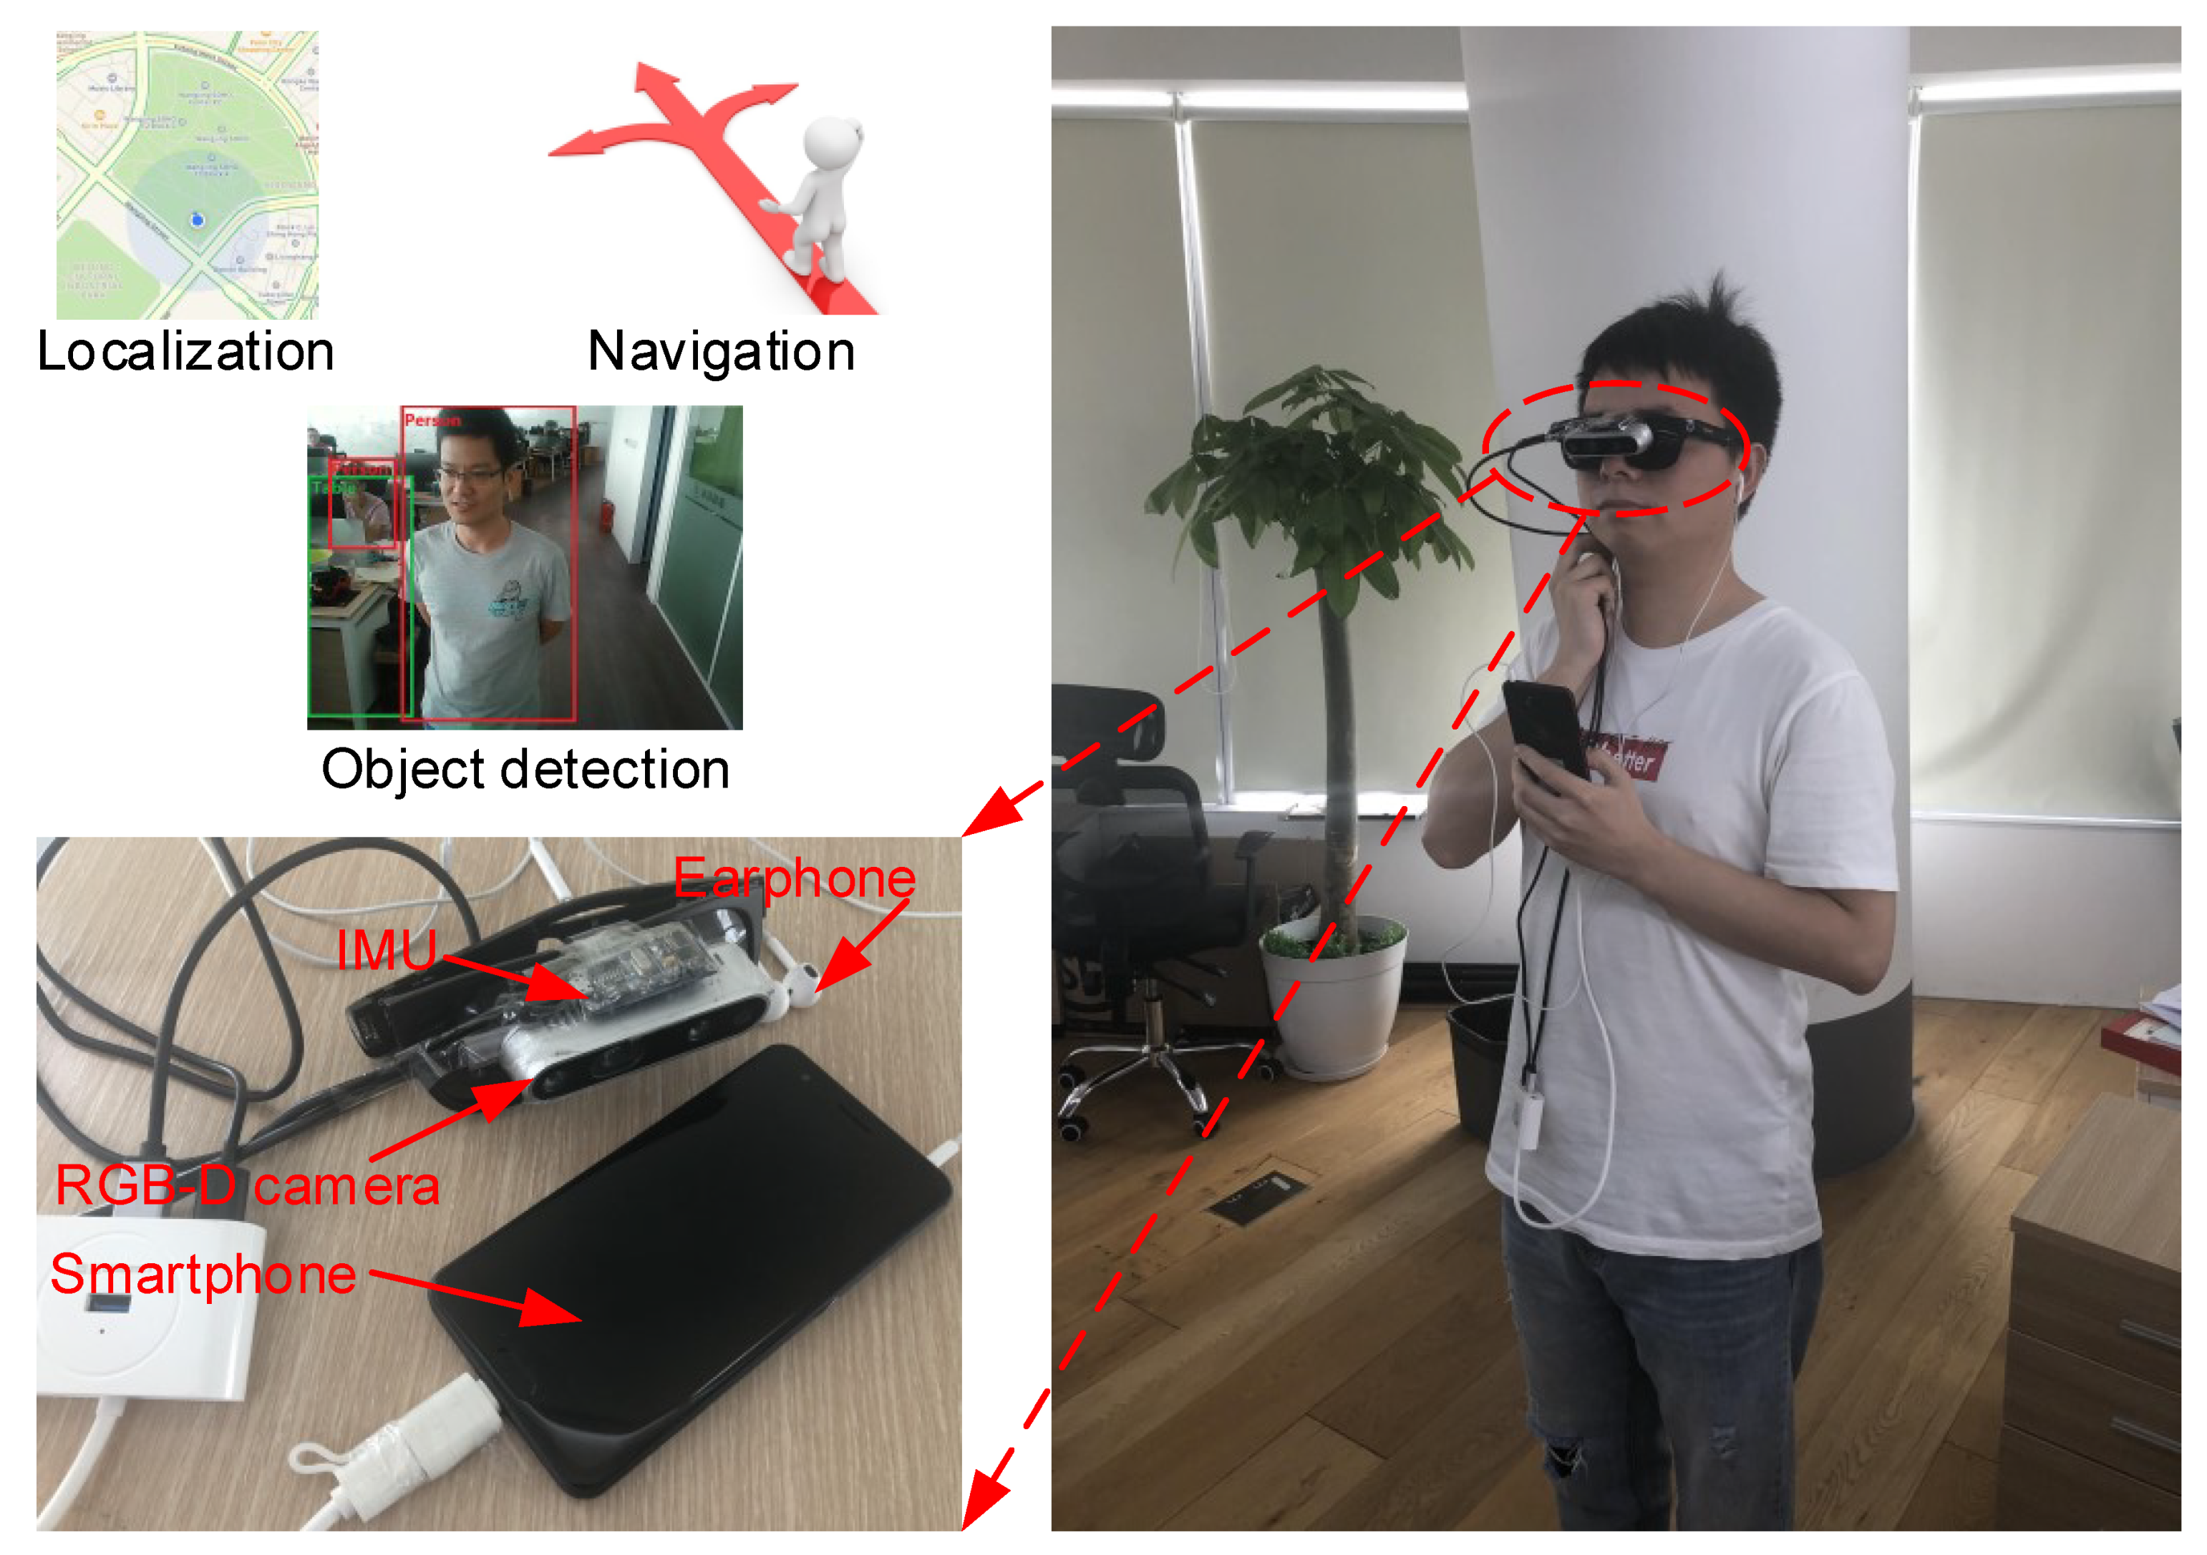
ABSTRACT
This project aims to assist visually impaired people with the help of latest technology named YOLO, meaning You Only Look Once.
This uses advanced RCNN techniques to classify objects. Classification of objects is facilitated with a set of weights given in the neural network.
These weights are used in the visual recognition model made using RCNN. With this, we get a model ready to be tested for object detection.
The webcam gives the video input in frames and then we detect objects in the surroundings what the frame has capture.
Now with what we capture, we give it to a text-to-speech library in python and we get the output voice in the speaker so that the visually impaired person can know what object lies in his surroundings.
Additionally, we use microphone to get the input from the user and tell him whether the object is there in his vicinity or not.

Slide 5
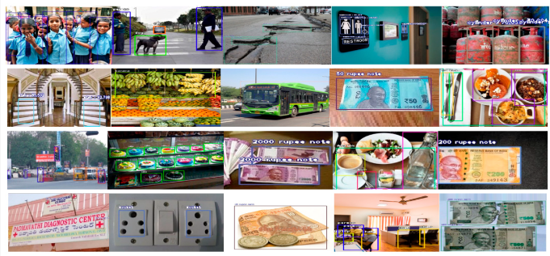
WHAT IS YOLO?
You Only Look Once(YOLO) is a popular real time object detection algorithm. It combines what was once a multi-step process, using a single neural network to perform both classification and prediction of bounding boxes for detecting objects

Slide 6
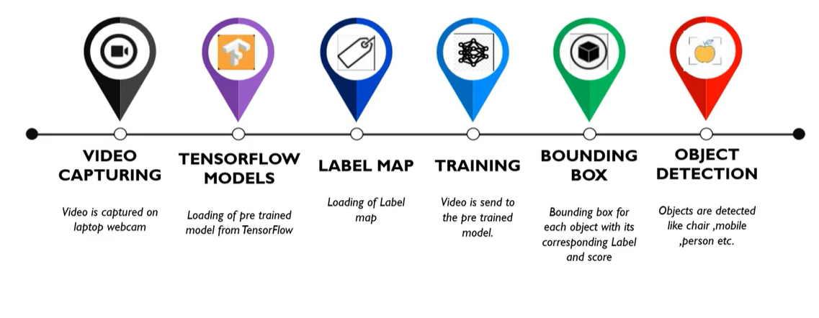
WHY YOLO?
FASTER
HIGHLY GENERALISED NETWORK
PROCESS FRAMES AT 45FPS

Slide 7
LITERATURE SURVEY
METHODS | TESTING ACCURACY | FRAME PROCESSING TIME
ALEXNET | 83.39 | 0.275S
VGG-16 | 86.80 | 0.53S
VGG-19 | 90.21 | 0.39S
YOLO-V3 | 95.19 | 0.1S

Slide 8
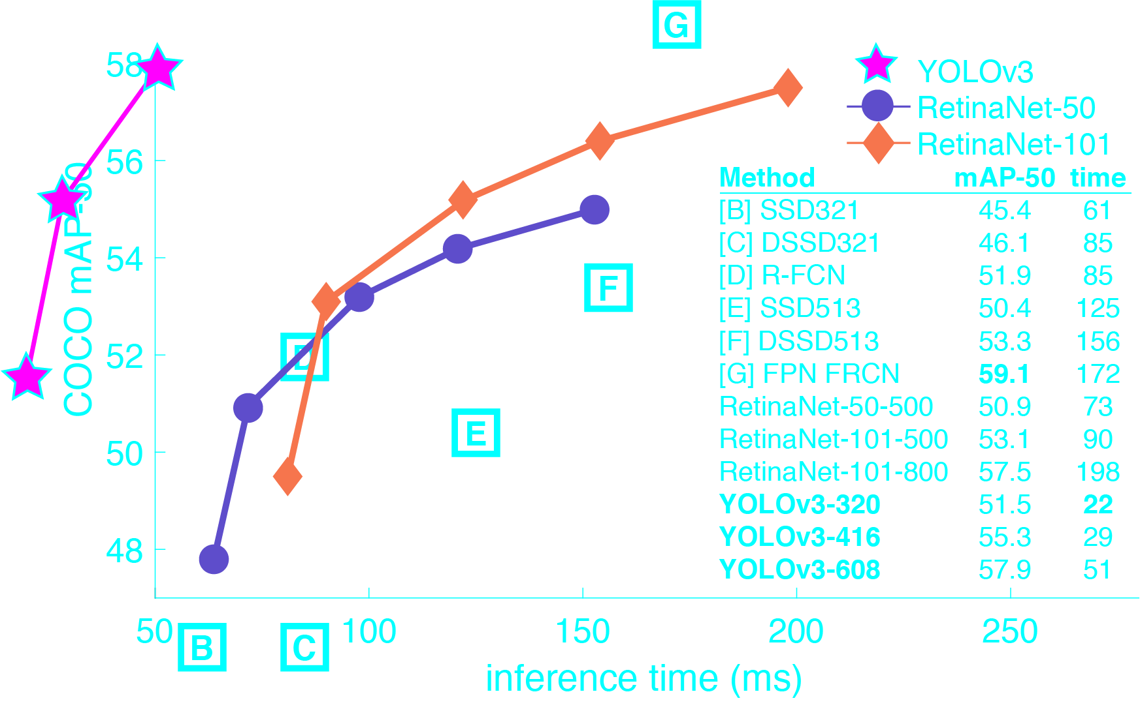
COMPARISON

Slide 9
COMPONENTS USED
RASPBERRY PI
KEYBOARD
SPECTACLES
LAPTOP
WEB CAM
PYTHON IDLE
SPEAKER
DISTANCE SENSOR

Slide 10
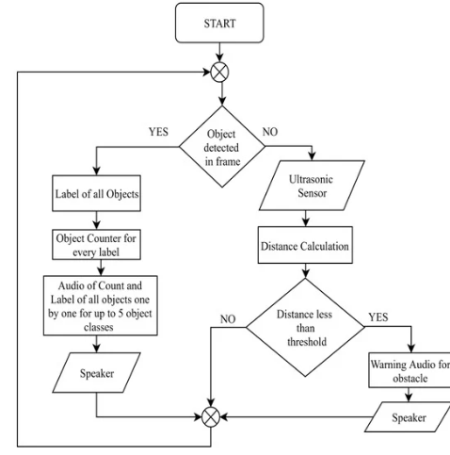
Flow Diagram

Slide 11
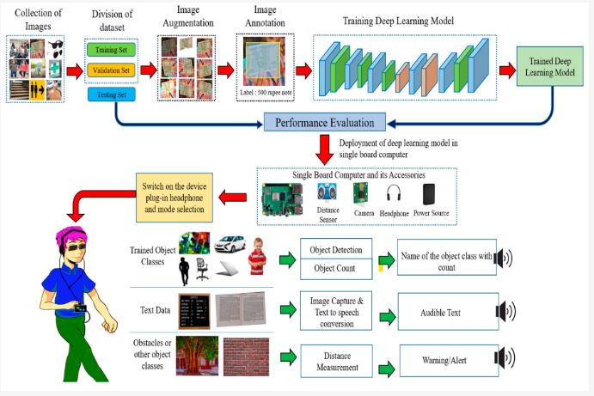
How does this work?

Slide 12
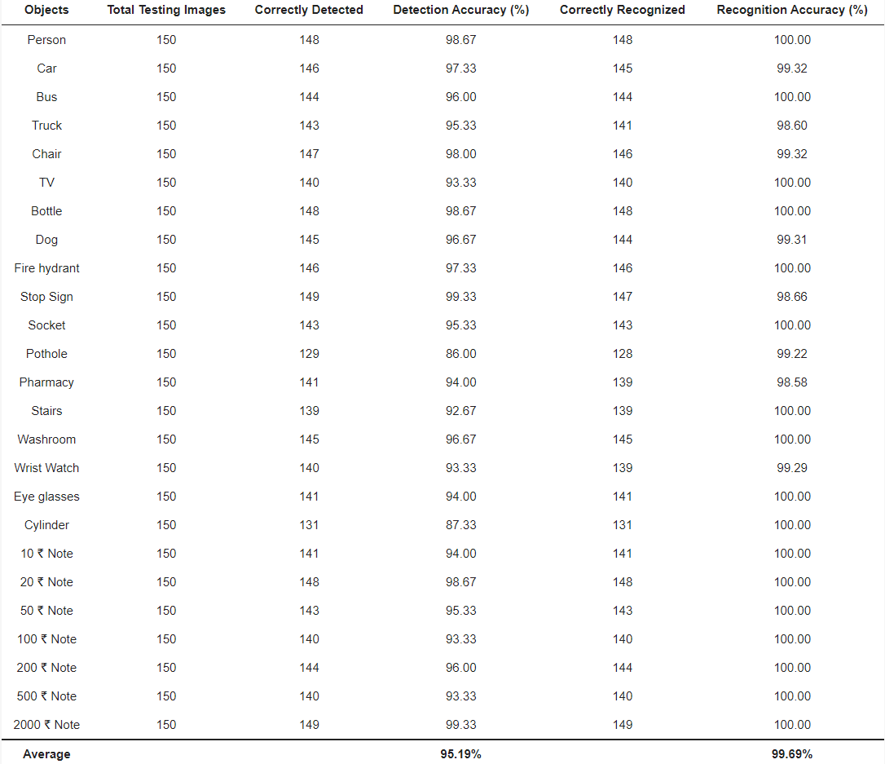
datasets

Slide 13
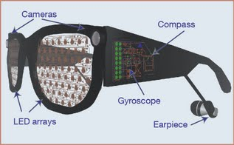
FUTURE WORK
Future work will focus on including more objects in the dataset, which can make the dataset more effective for assisting visually impaired people. It will be connected to more sensors that will detect, for example, the ground floor and other trajectories, which will provide a wider range of assistance to the visually impaired.

Slide 14
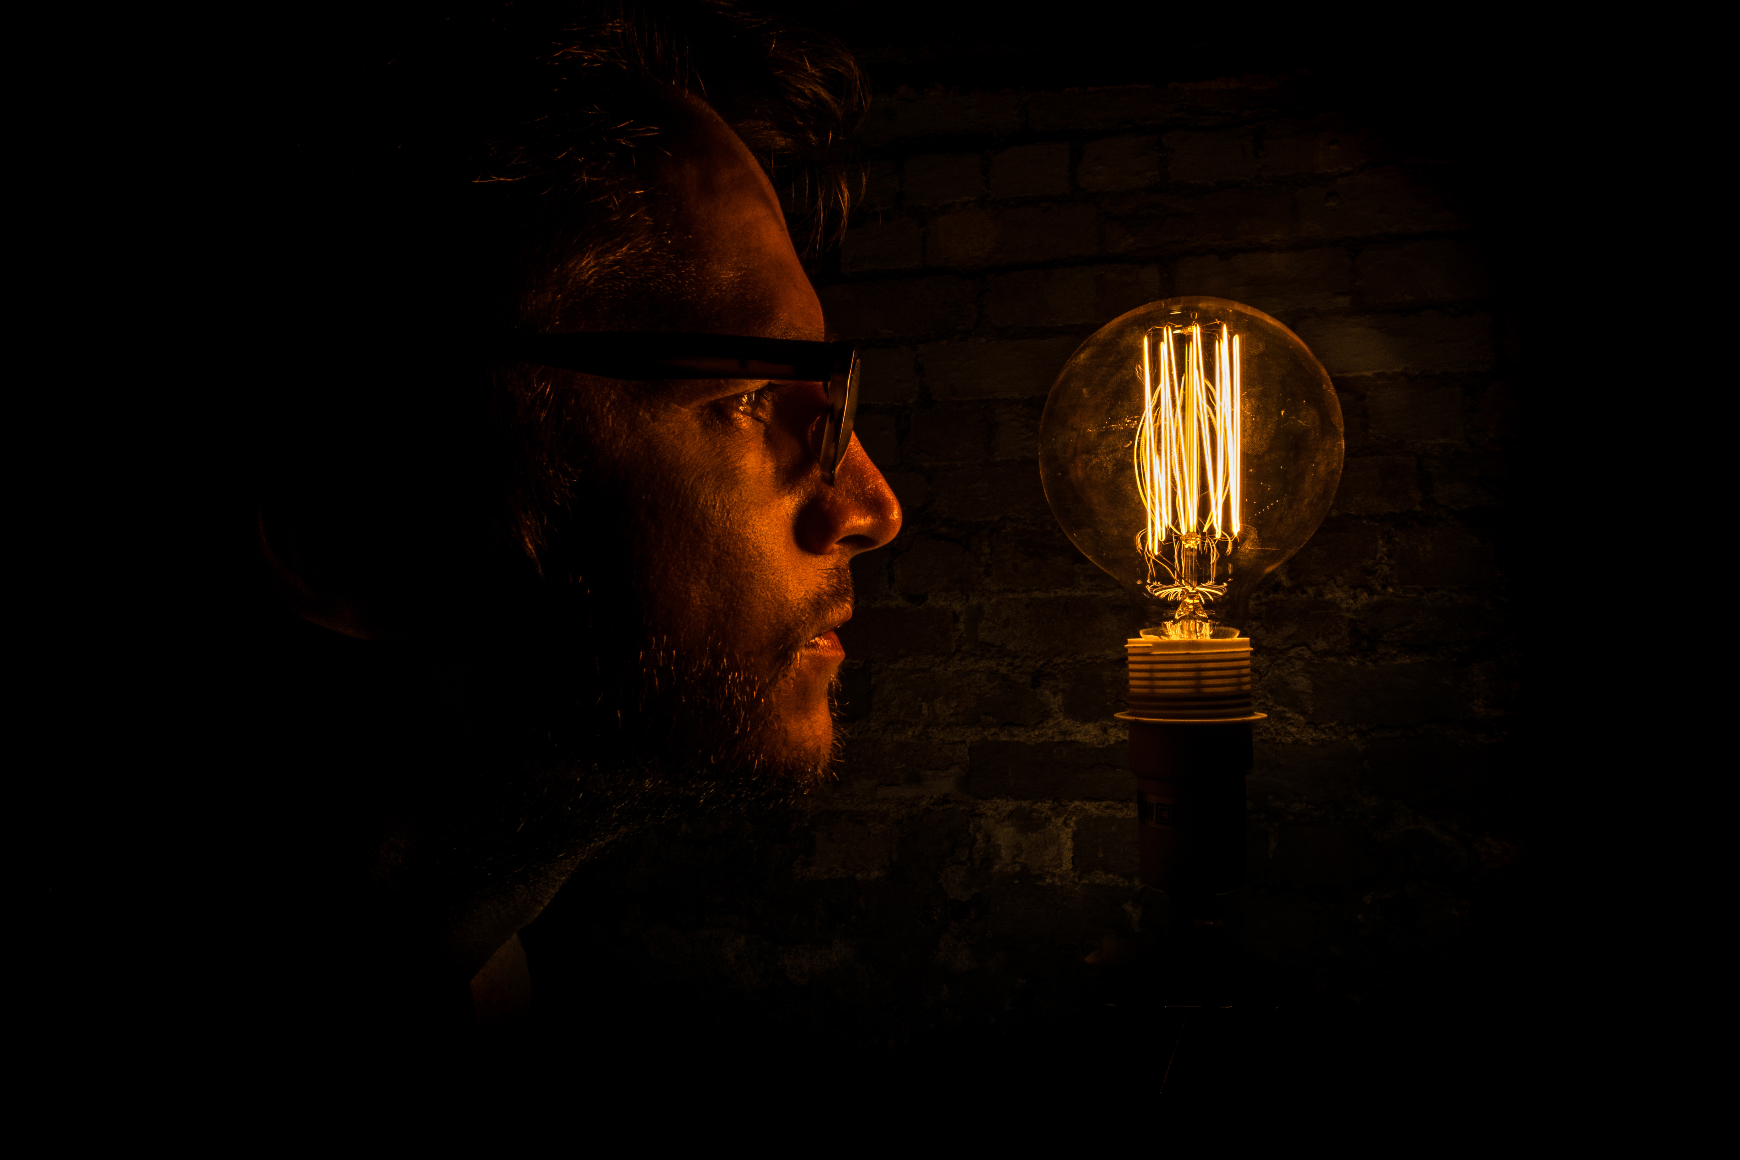
THANK YOU!
LET THE LIGHT SHINE OUT OF DARKNESS

